Slide 1
Beginning Morse Code
This is the font size of the presentation so make sure you can view it from your seat...

Slide 2
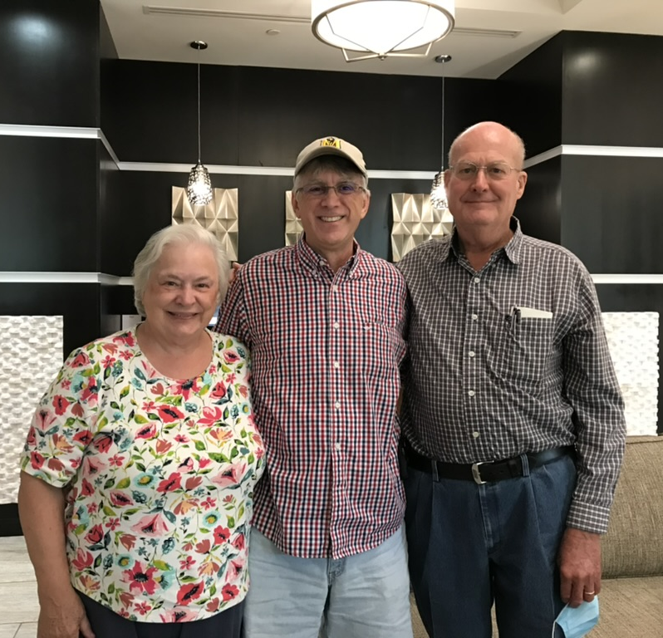
Hello
Keith Ford, K4KEF
keith@keithford.com
keithford.com/files

Slide 3
Challenge Question
Who here already knows morse code?
Fastest speed?
40 WPM?
Notes:
40 WPM

Slide 4
Terminology
CW – continuous wave, the signal used to broadcast Morse code,
often used interchangeably.
QSO – an exchange between radio operators
QRP – low power signal, typically less than 5 watts
WPM – words per minute
IMHO – In My Humble Opinion (this entire presentation)

Slide 5
Why Me? 😀
1983 – learned 5wpm Morse code for Novice license

Slide 6
Why Me? 😮
1983 – learned 5wpm Morse code for Novice license
1986 – starting learning Morse code again

Slide 7
Why Me? ☹️
1983 – learned 5wpm Morse code for Novice license
1986 – starting learning Morse code again
2001 – let my license expire

Slide 8
Why Me? 😷
1983 – learned 5wpm Morse code for Novice license
1986 – starting learning Morse code again
2001 – let my license expire
2020 – Covid Summer >> Technician, General, and Extra

Slide 9
Why Me? 🧐
1983 – learned 5wpm Morse code for Novice license
1986 – starting learning Morse code again
2001 – let my license expire
2020 – Covid Summer >> Technician, General, and Extra
2021 – built Morserino-32 with Jerry (KF4BOE) began learning Morse code again

Slide 10
Why Me? 🤔
1983 – learned 5wpm Morse code for Novice license
1986 – starting learning Morse code again
2001 – let my license expire
2020 – Covid Summer >> Technician, General, and Extra
2021 – built Morserino-32 with Jerry (KF4BOE) began learning Morse code again
2023 – interested in QRP CW POTA, now I am learning Morse code…

Slide 11
Why Me? 🤪
1983 – learned 5wpm Morse code for Novice license
1986 – starting learning Morse code again
2001 – let my license expire
2020 – Covid Summer >> Technician, General, and Extra
2021 – built Morserino-32 with Jerry (KF4BOE) began learning Morse code again
2023 – interested in QRP CW POTA, now I am learning Morse code…
again

Slide 12
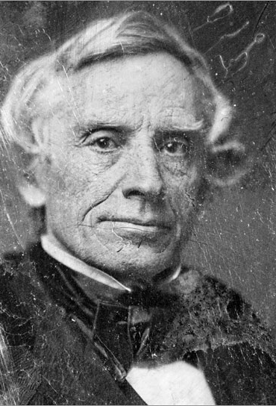
What is Morse Code?
In 1832, Samuel Morse was traveling to the United States from Europe on a ship when he overheard a conversation about electromagnetism that inspired his idea for an electric telegraph. Though he had little training in electricity, he realized that pulses of electrical current could convey information over wires.
Notes:
Any ideas how Morse code is linked to the Mission Impossible movies?

Slide 13
Challenge Question
Will buying a boat and spending time on the water help you learn morse code?

Slide 14
Hello
Jerry Poplin
KF4BOE

Slide 15
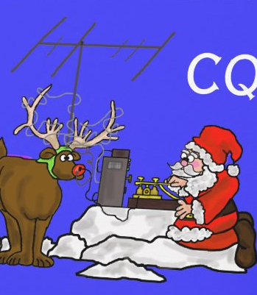
Why Learn Morse Code
Challenging ➔ Rewarding
POTA / SOTA / IOTA
More bang per watt – 3kHz vs 100Hz
DX
QRP & QRPp
Gear can be small and simple and cheap
Notes:
Show Pixie $2 on Ali Express

Slide 16
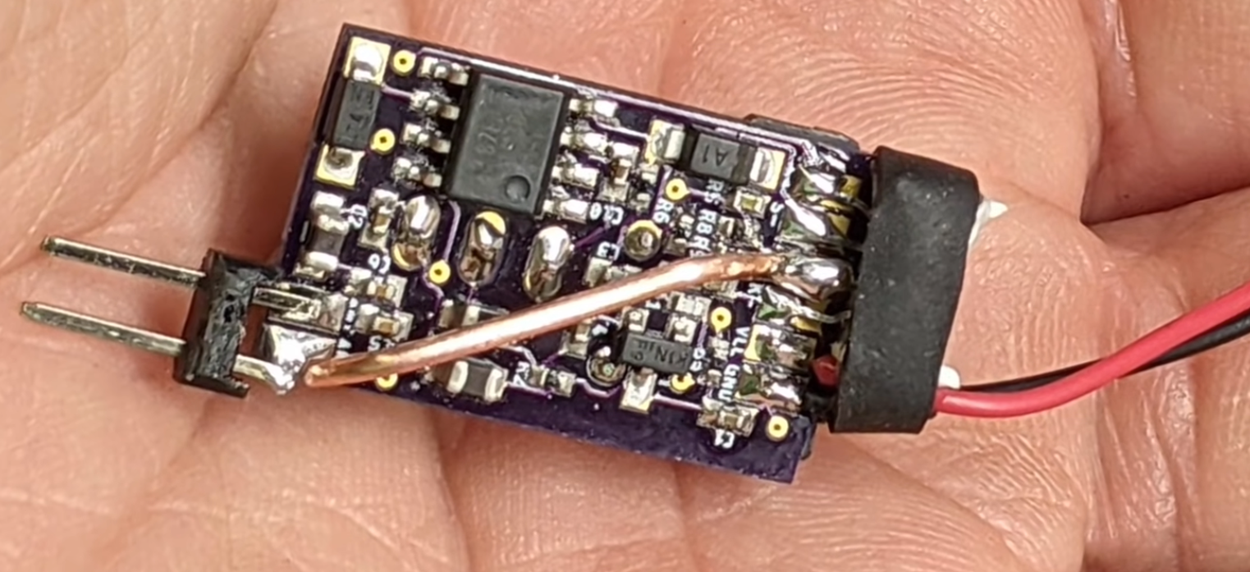
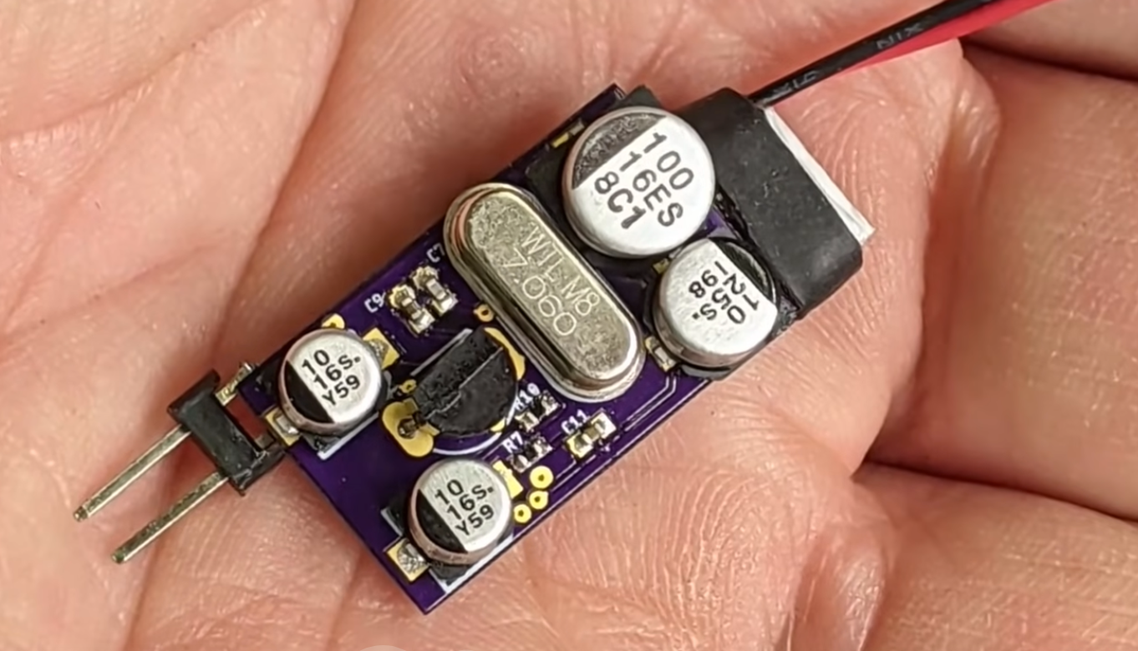
Micro SOTA 850 mW 2.7 grams
key ➔

Slide 17
It’s Magic
Modern, but old
Used by generations past
Free as in freedom

Slide 18
Challenge Question
How is Mission Impossible theme song related to Morse Code?

Slide 19
Challenge Question
How is Mission Impossible theme song related to Morse Code?

Slide 20
How NOT To Learn Morse Code
Morse code is an aural language, you need to learn it with your ears, not your eyes.
Attempts to learn it using any visual means may work initially but will most likely cause you to hit a wall when trying to increase your speed.

Slide 21
How NOT To Learn Morse Code
Morse code is an aural language, you need to learn it with your ears, not your eyes.
Attempts to learn it using any visual means may work initially but will most likely cause you to hit a wall when trying to increase your speed.
Don’t use your eyes???

Slide 22
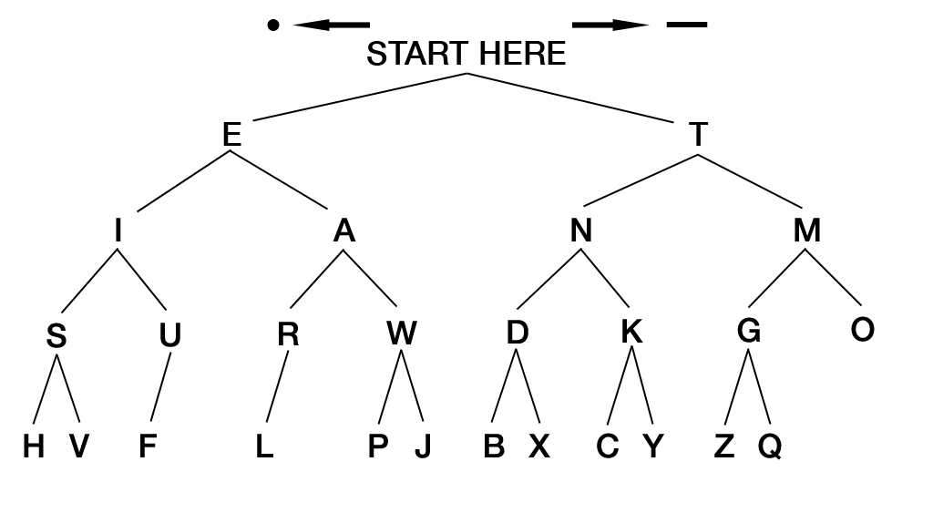
Notes:
Quick, what character is DI-DAH-DI-DIT?

Slide 25
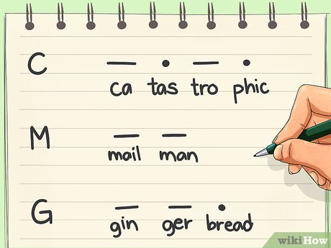
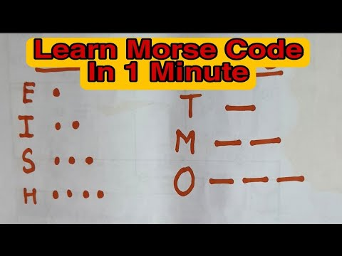

Slide 27
How To Learn Morse Code
Practice, Practice, Practice, Practice, Practice, Practice, …
Notes:
Who learning Morse code has a roommate?

Slide 28
Methods
Learn by sound of the letter, then eventually the sound of entire words (do not count dits & dahs)
L is not “dot dash dot dot”, but “di-dah-di-dit”
Farnsworth – target character speed, adjust character spacing
20/10 is common, may need go to 30wpm
Koch – learn characters in certain order, start with two, add more as you become proficient
Most Apps support Farnsworth and Koch
Notes:
May need to go faster to avoid trying to count dits and dahs.
30/8
Don’t go too slow. 5 wpm is painful.

Slide 29
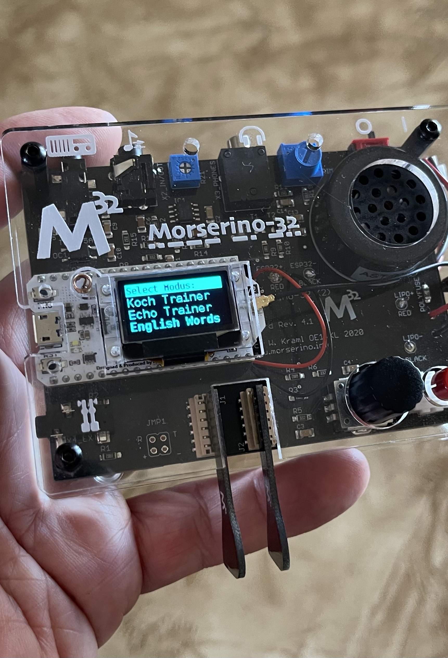
Helpful Tools
Hardware (mostly sending)
Code Practice Oscillators
Decoders
Practice correct timing when learning to send with a straight key
Morserino-32 kit
CW Trainer, Echo Trainer, CW Decoder, CW Transceiver using LoRa or Internet
qsobot.online
Notes:
Morserino-32 is $115 from Austria.

Slide 30
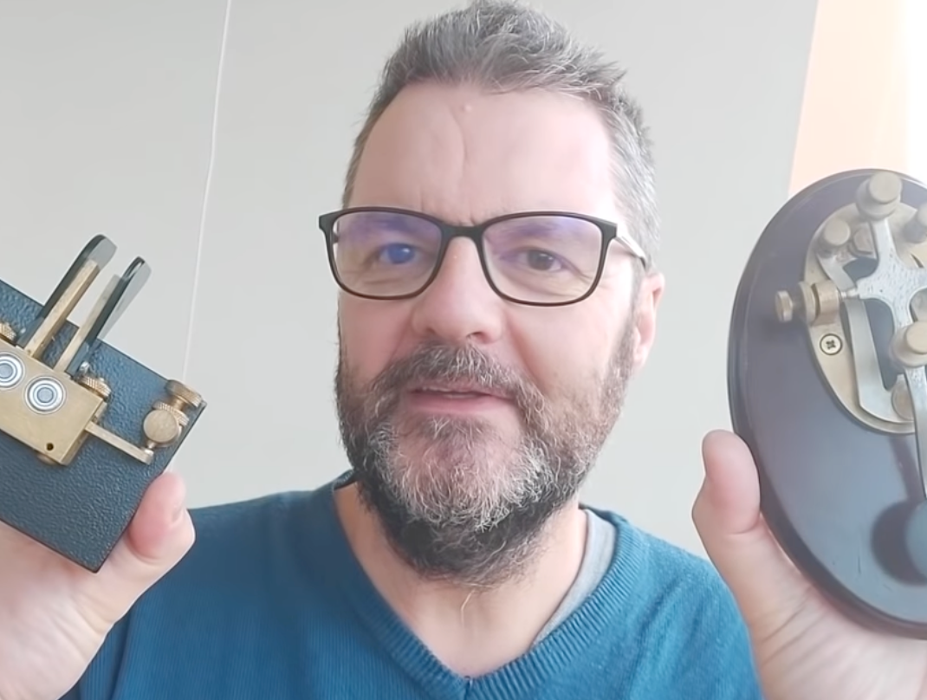
Sending: Key vs Paddles
When one uses a straight key, one must use precise timing since the code is produced by physical manipulation. A paddle is different from a straight key since the difference in timing between the “dits” and the “dashes” is built into the unit.
Notes:
Gil Gruson F4WBY the Radio Prepper from France.

Slide 31
Apps
Web
lcwo.net
longislandcwclub.org
morsecode.ninja
Mobile Apps
Ham Morse
Morse Toad
Morse Machine
Morse Mentor Pro
Morse Mania
Desktop Apps
CW Trainer by G4FON
Some apps will send real QSOs, current headlines, and let you upload your own content.
They can also simulate real listening conditions such as band noise.
Notes:
LICC is a great way to start out with a support group.

Slide 32
Tips
Use both Koch and Farnsworth methods at the same time.
Practice 10-15 minutes twice a day. * Habit Stacking *
Track your progress. Some apps do this for you.
Learn to copy before learning to send.
CW operators will have “accents” so listen to real QSOs. (No radio? Try websdr.org)
If you struggle, seek an elmer.

Slide 33
Challenge Question
What one word sums up this presentation?

Slide 34
Challenge Question
What one word sums up this presentation?
PRACTICE

Slide 35
Questions?
keithford.com/files

