Slide 1
How NOT
To Learn
Morse
Code
The first message ever sent using Morse code was "What hath God wrought?". This message was sent by Samuel Morse on May 24, 1844, from Washington, D.C. to Baltimore.
A few seconds later the reply arrived. "We've been trying to reach you about your car warranty."

Slide 2
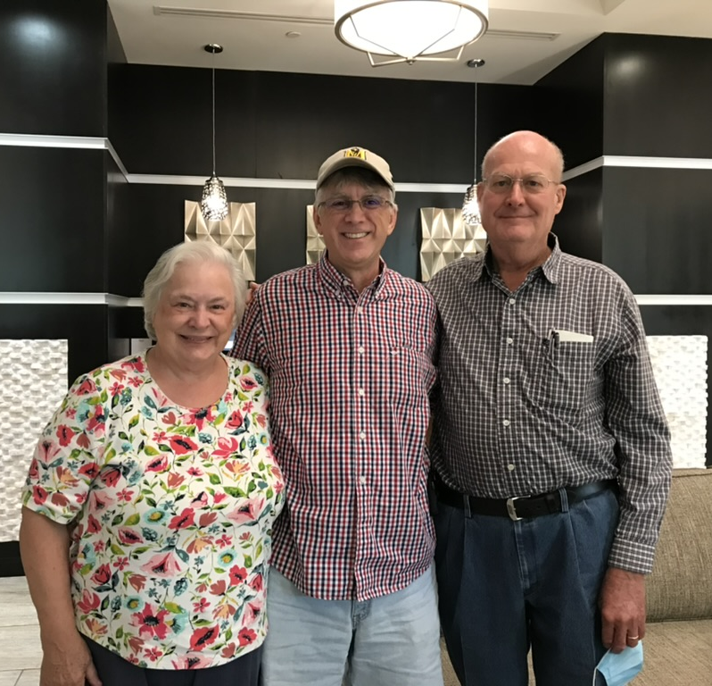
Hello
Keith Ford
K4KEF@keithford.com

Slide 3
If anyone takes photos during the session, please share them to K4KEF@keithford.com

Slide 4
TL;DR
keithford.com/files
Learn by sound only, do not use
picture or word associations
Practice – Patience – Persistence
It’s not easy – take a friend

Slide 5

How NOT To Learn Morse Code
Morse code is an aural language, you need to learn it with your ears, not your eyes.
Do not use word or picture association
Attempts to learn it using any visual means may work initially but will most likely cause you to hit a wall when trying to increase your speed.

Slide 6
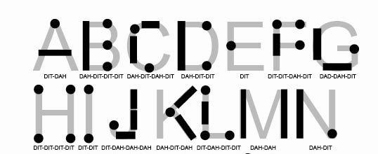

Slide 7
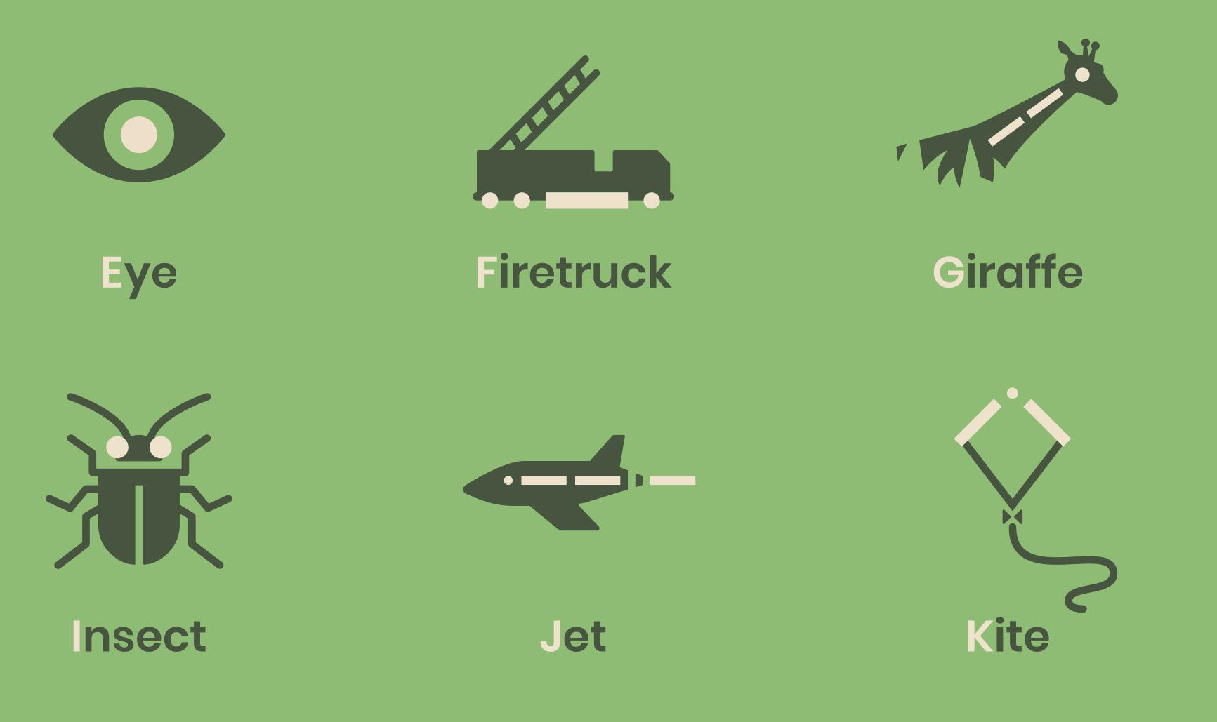

Slide 8
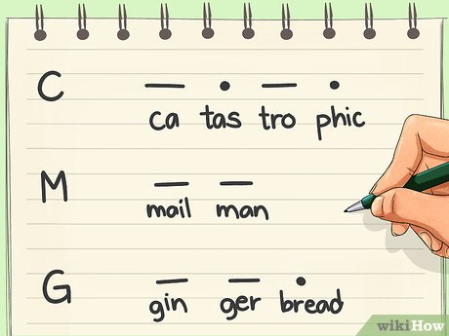
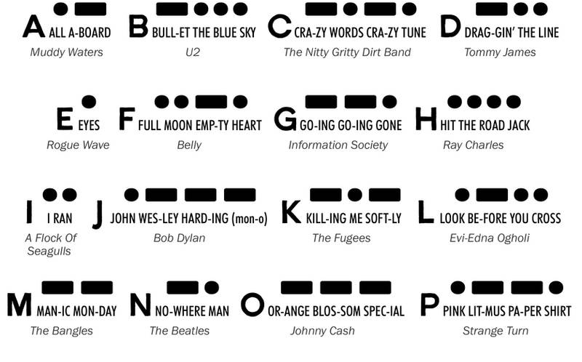
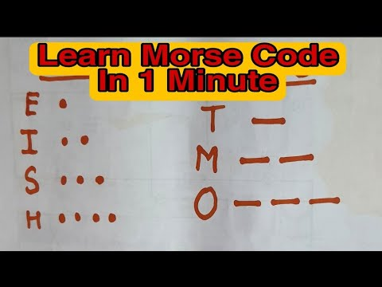


Slide 9


Slide 10
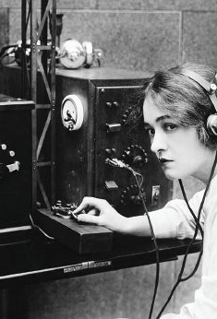
How To Learn
Morse Code
If you ask 10 people how to learn Morse code, you'll get 12 answers.
It comes down to the basics:
Practice
Patience
Persistence

Slide 11
Recommended Methods
Learn by sound of the letter (do not count dits & dahs)
  L is not “dot dash dot dot”, but “di-dah-di-dit”
Koch – learn characters in certain order, start with two, add more as you become proficient
Farnsworth – target character speed, adjust character spacing
  20/10 is common, we suggest using 30wpm character speed
Most Apps support Farnsworth and Koch
Now, what is character speed and WPM?

Slide 12
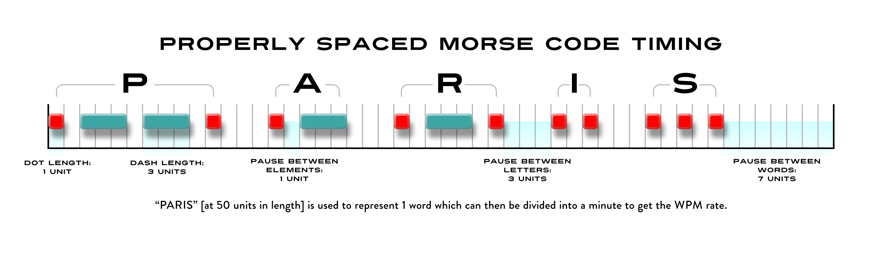
What is Morse Code?
di - dah - dah - dit di - dah di - dah - dit di - dit di - di - dit

Slide 13
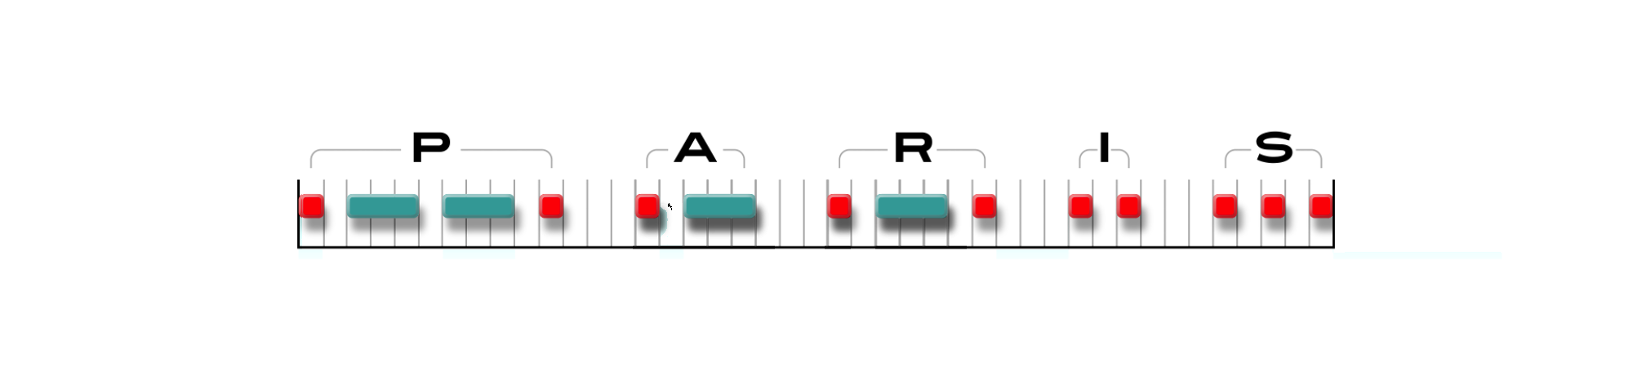
How Does Farnsworth Help?

Slide 14
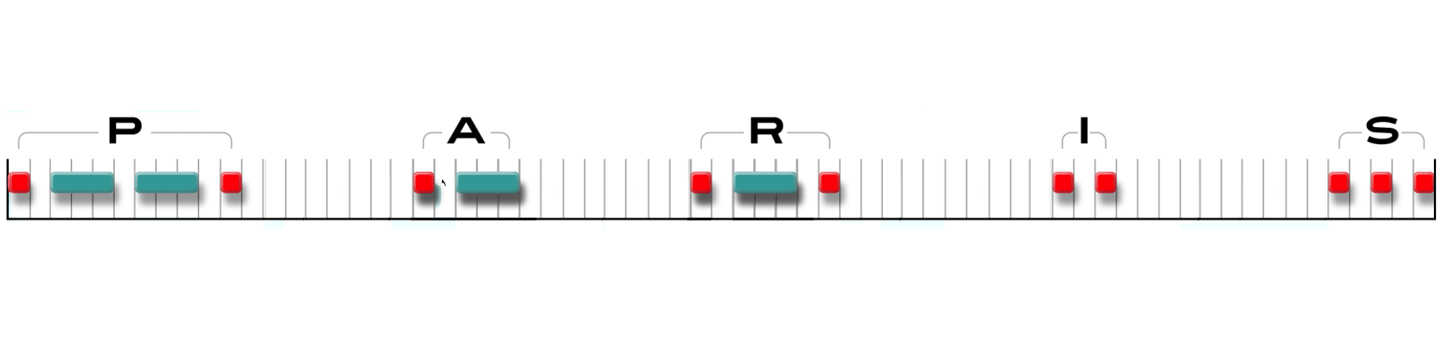
How Does Farnsworth Help?

Slide 15
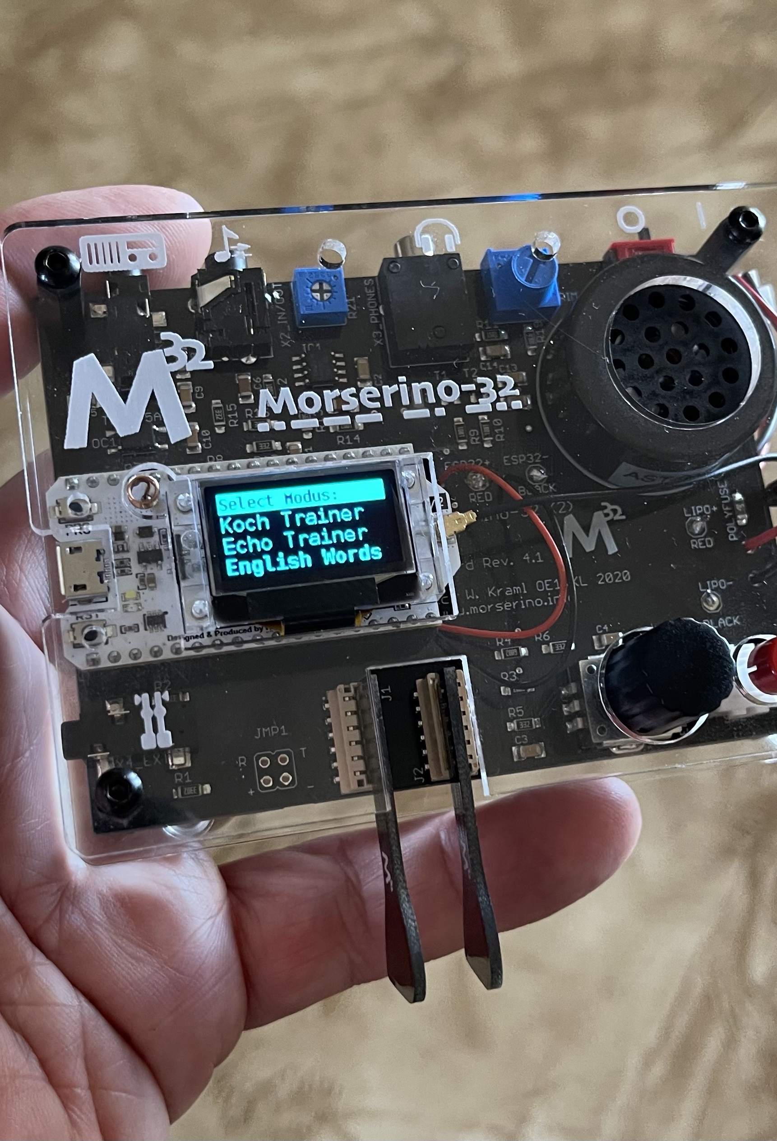
Helpful Tools
Hardware
  Code Practice Oscillators
  Decoders
    Practice correct timing when learning to send with a straight key
  Morserino-32 kit
    Koch Trainer, Echo Trainer, CW Decoder
    CW Transceiver using WiFi
    qsobot.online

Slide 16
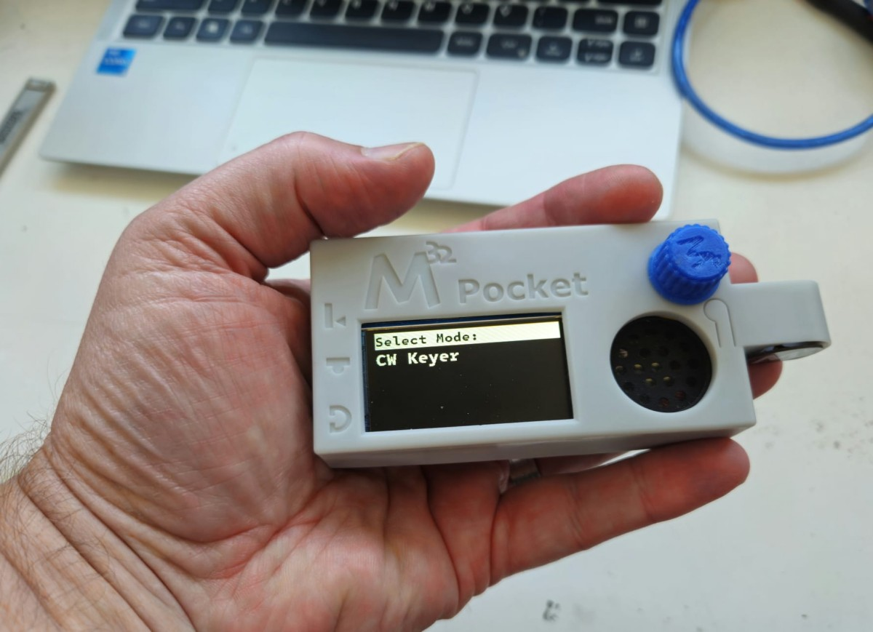
www.morserino.info qrp-labs.com

Slide 17
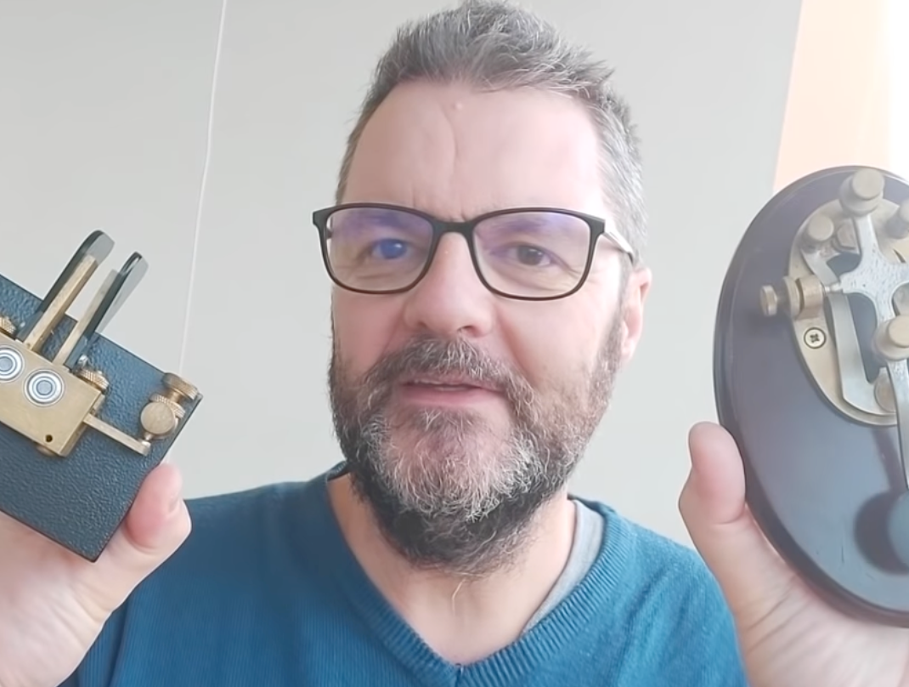
Sending:
Key vs Paddles
Be comfortable with copying code before you start to practice sending.
When one uses a straight key, one must use precise timing since the code is produced by physical manipulation. A paddle is different from a straight key since the difference in timing between the “dits” and the “dahs” is built into the unit.
Learn sending with a straight key to ingrain these timings.

Slide 18
Apps
Web Apps
  lcwo.net
  longislandcwclub.org
  morsecode.ninja
  morsecode.world
  learnmorsecode.org
Mobile Apps
  Morse Maven
  Ham Morse
  Morse Toad
  Morse Machine
  Morse Mentor Pro
  Morse Mania
Desktop Apps
  CW Trainer by G4FON
Some apps will send real QSOs, current headlines, and let you upload your own content.
They can also simulate real listening conditions such as band noise and signal fade.
Warning about keyboard usage
with some apps

Slide 19
Take
Away
Tips
Use both Koch and Farnsworth methods at the same time.
Practice 10-15 minutes twice a day.
* Habit Stacking *
CW operators will have “accents” so listen to real QSOs.
No radio? Try websdr.org
Find slow operators at hamalert.org
If you struggle, seek a practice buddy or join an online CW club. This can add even more fun.
Questions?

Slide 20

Scott Wooten-KW4NJA
Athens, GA
Licensed in 2021
LICW Member 2022
Instructor 2023
POTA/Contesting/DX/Ragchews
Member of LICW, SKCC, CWOps, SECC

Slide 21

About Our Club…
Founded in 2018
CW operators needed / Field Day 2017
Give back to the community
Goal: 50 members / Long Island area
More successful than we dreamed
Almost 8000 current members
All 50 US States
70+ countries around the world
100+ Instructors and Moderators
180+ Zoom Classes/Forums weekly
English & Spanish
Notes:
HOWARD

Slide 22

the licw CURRICULUM
MP
At each level we offer sending classes to provide feedback to students as to how their fist sounds.
We focus a lot on straight key sending in the Beginner’s Sending classes, as this is where the most impact can be made—ensuring good element and character formation, including spacing.
In addition, specialty forums are offered for sending with sideswipers, bugs, and single/dual lever paddles.
Notes:
And so now you have seen how we introduce characters one at a time in the Koch Method. At Koch’s recommended 12 WPM. And in a sequence optimized for initial learning. How we ensure the new characters are being perceived as single acoustics sounds. How we establish character sound familiarity before finally transitioning to recognition or copy with a focus on time to recognize and not dwelling on mistakes. And we do this methodically for each Morse character. Combined, we refer to this as The LICW Method and we believe it gives the adult learners the best opportunity for success to deeply learn the code and achieve proficiency.
Now Howard, Jim, and some other friends will tell you more about our club.

Slide 23
the licw method
MP
Character Introduction in the Koch Method (single letter)
12 WPM- Allows learning acoustic sounds while using a SK
Character sequence based on QSO Protocol
Ensure characters heard as single acoustic sounds
Establish character sound familiarity
Notes:
And so now you have seen how we introduce characters one at a time in the Koch Method. At Koch’s recommended 12 WPM. And in a sequence optimized for initial learning. How we ensure the new characters are being perceived as single acoustics sounds. How we establish character sound familiarity before finally transitioning to recognition or copy with a focus on time to recognize and not dwelling on mistakes. And we do this methodically for each Morse character. Combined, we refer to this as The LICW Method and we believe it gives the adult learners the best opportunity for success to deeply learn the code and achieve proficiency.
Now Howard, Jim, and some other friends will tell you more about our club.

Slide 24
A Special Culture
No officers or board of directors
Bottom-Up organization
Core values: empathy, kindness & respect
No criticism & no controversial topics
Mantra: “Prepare Students to Get on The Air”
Broader goals: fun, socializing, friendships and bonds around shared goals & interests
GET
ON THE AIR
Notes:
HOWARD

Slide 25
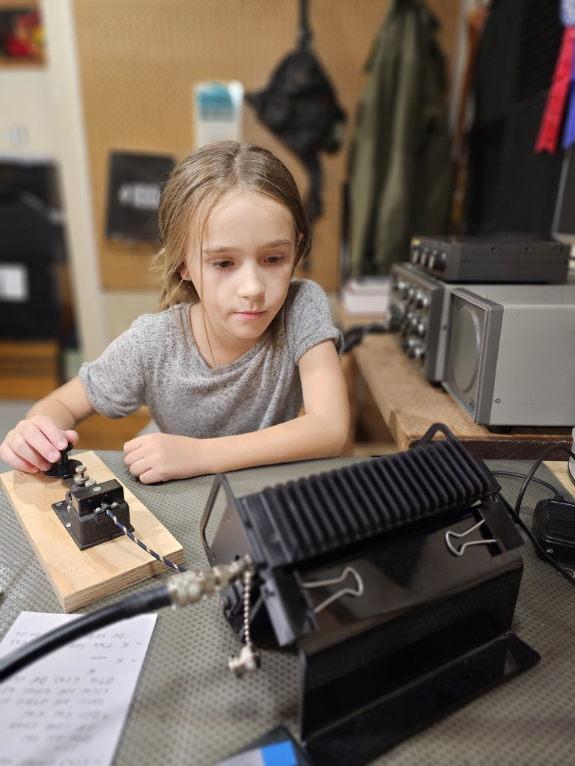
Kids Program
Developed during COVID
Small classes of 3-5 kids
One-on-one when needed
Ages 5 to 17
U.S., Canada, and the U.K.
Curriculum modified for kids
Over 600 have learned CW
Notes:
Bob, W7JNM
Katie, KQ4HRI

Slide 26
Weekly Forums
Boat Anchors
QRP
Contesting
Technology
Antennas
DXpeditions
Historical Events
Morserino Users
Satellites
POTA and SOTA
Wild About Bugs
Elmer 101
Portable Ops
Electronic Theory
Notes:
Jim

Slide 27


questions?
Notes:
HOWARD

Slide 28

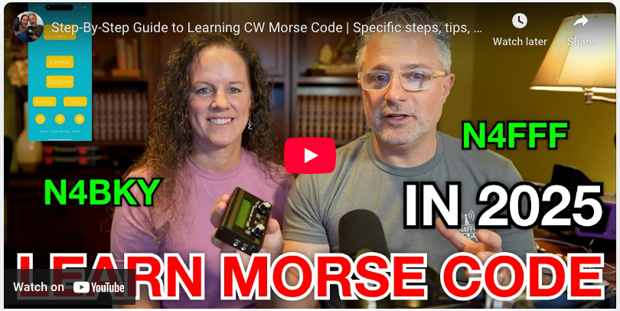
HamRadioDuo
Mike N4FFF and Becky N4BKY
Notes:
Hi, we’re Mike and Becky. You might know us from YouTube as the HamRadioDuo!
… pleasantries and introduction

Slide 29
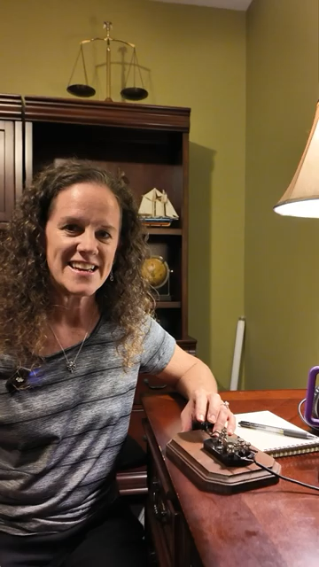
Fun
Notes:
Try to play this 1 minute video with clips our our adventures.
As Keith and Jerry have shared, there really is something special about morse code and CW. Morse code unlocks being able to use tiny radios, which in turn unlocks being able to bring them anywhere including outdoors to the park, hiking, the beach, and so much more.
We started our channel so that we can share how much fun we are having. We also started our channel to share our challenges along the way.
Mike learned what he believes is the hard way. Becky learned a what we think is a faster and easier way.
Mike learned by memorizing the dits and dahs. After tons of work to get there, he couldn’t actually copy anything of appropriate speed. He eventually gave up and put the radios in a drawer.
Becky wanted to learn just for the challenge, Mike picked it back up but searched for a better way. This time, Becky started off with the new methods and Mike re-learned.
We share our journey so that people can see the reward of how fun it is and encourage anyone who wants to learn.

Slide 30
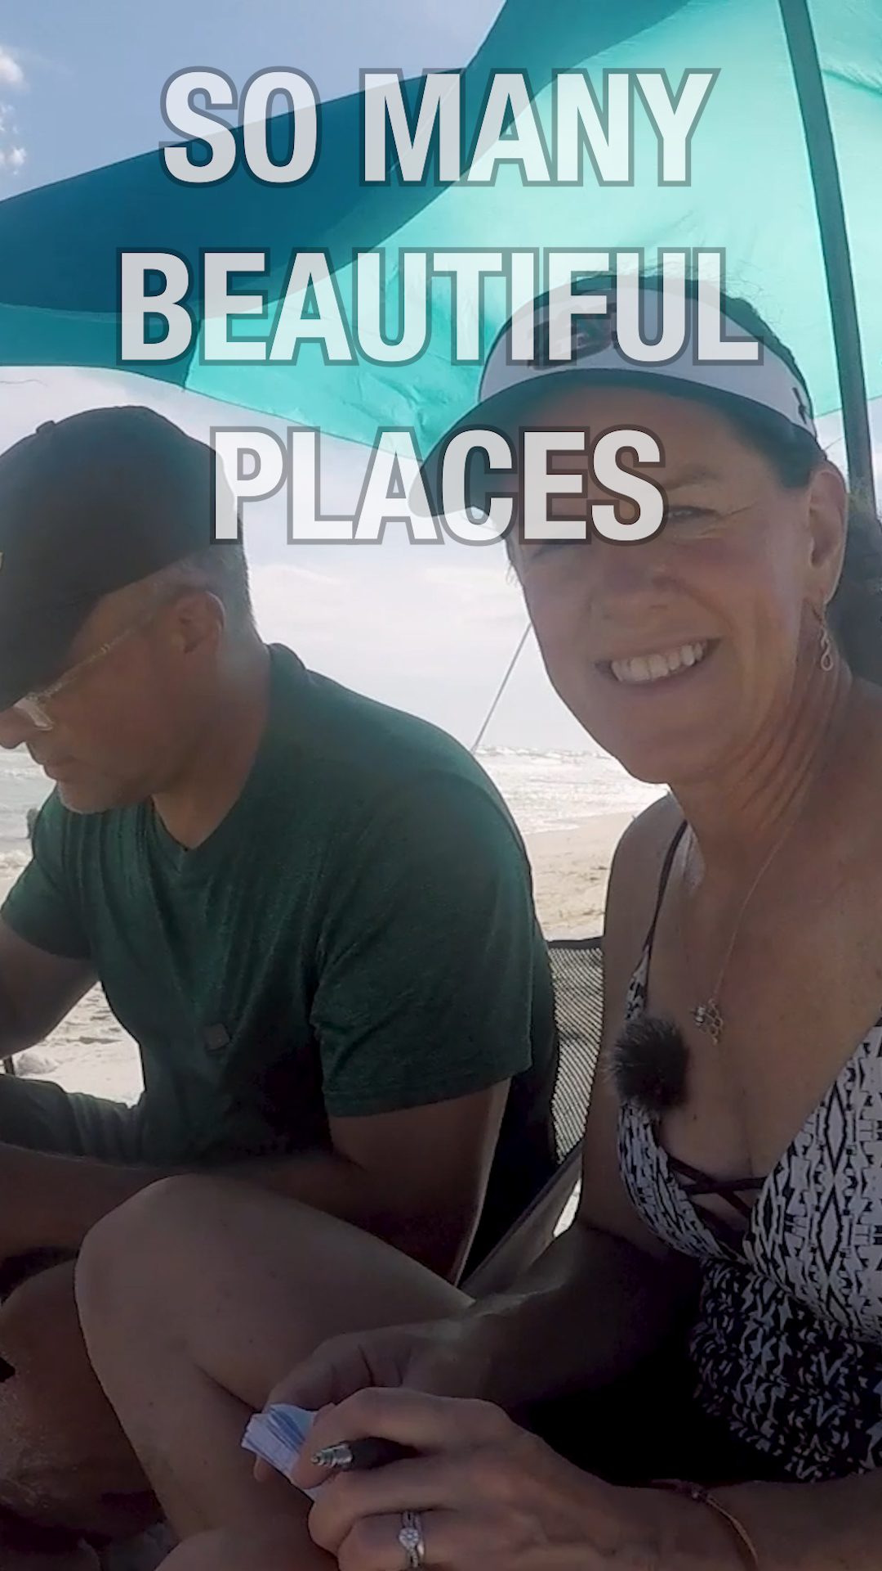
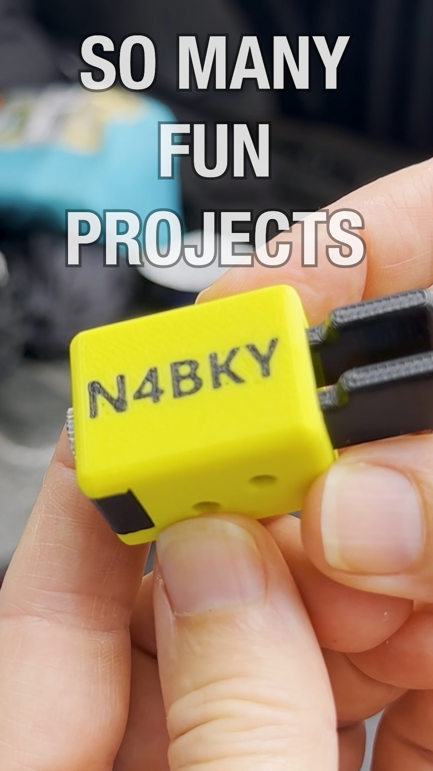
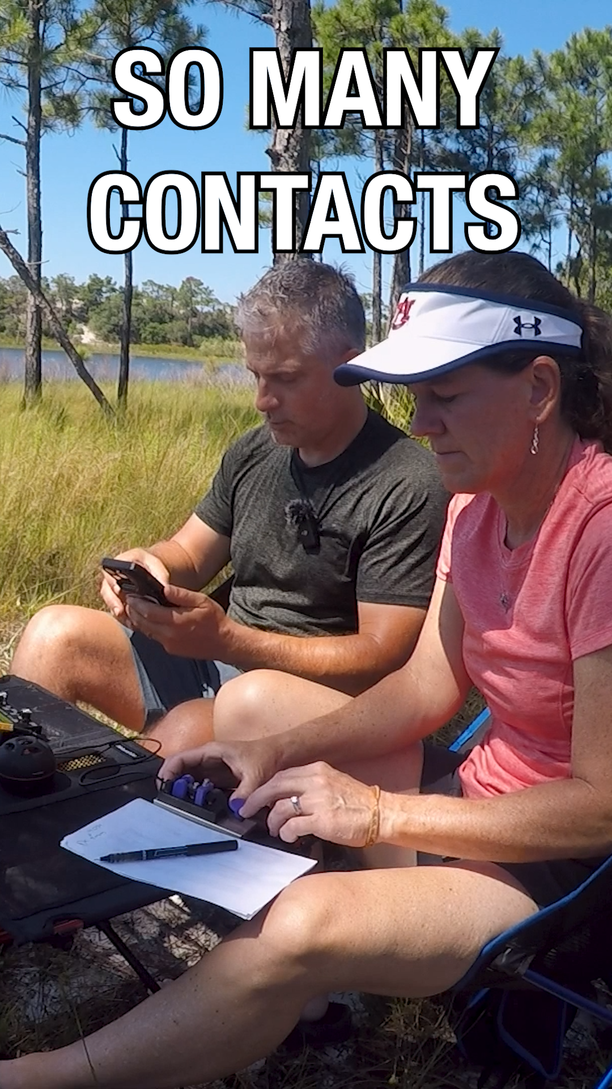
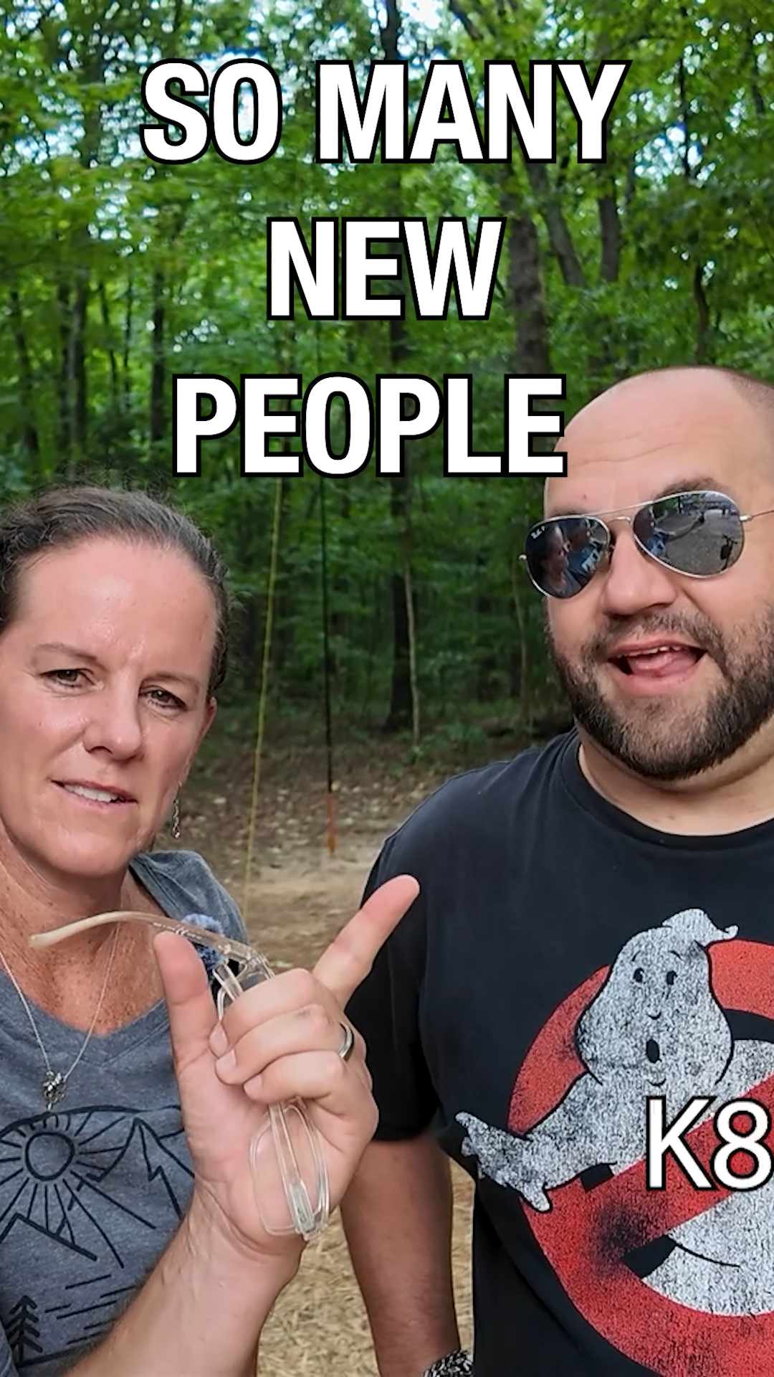
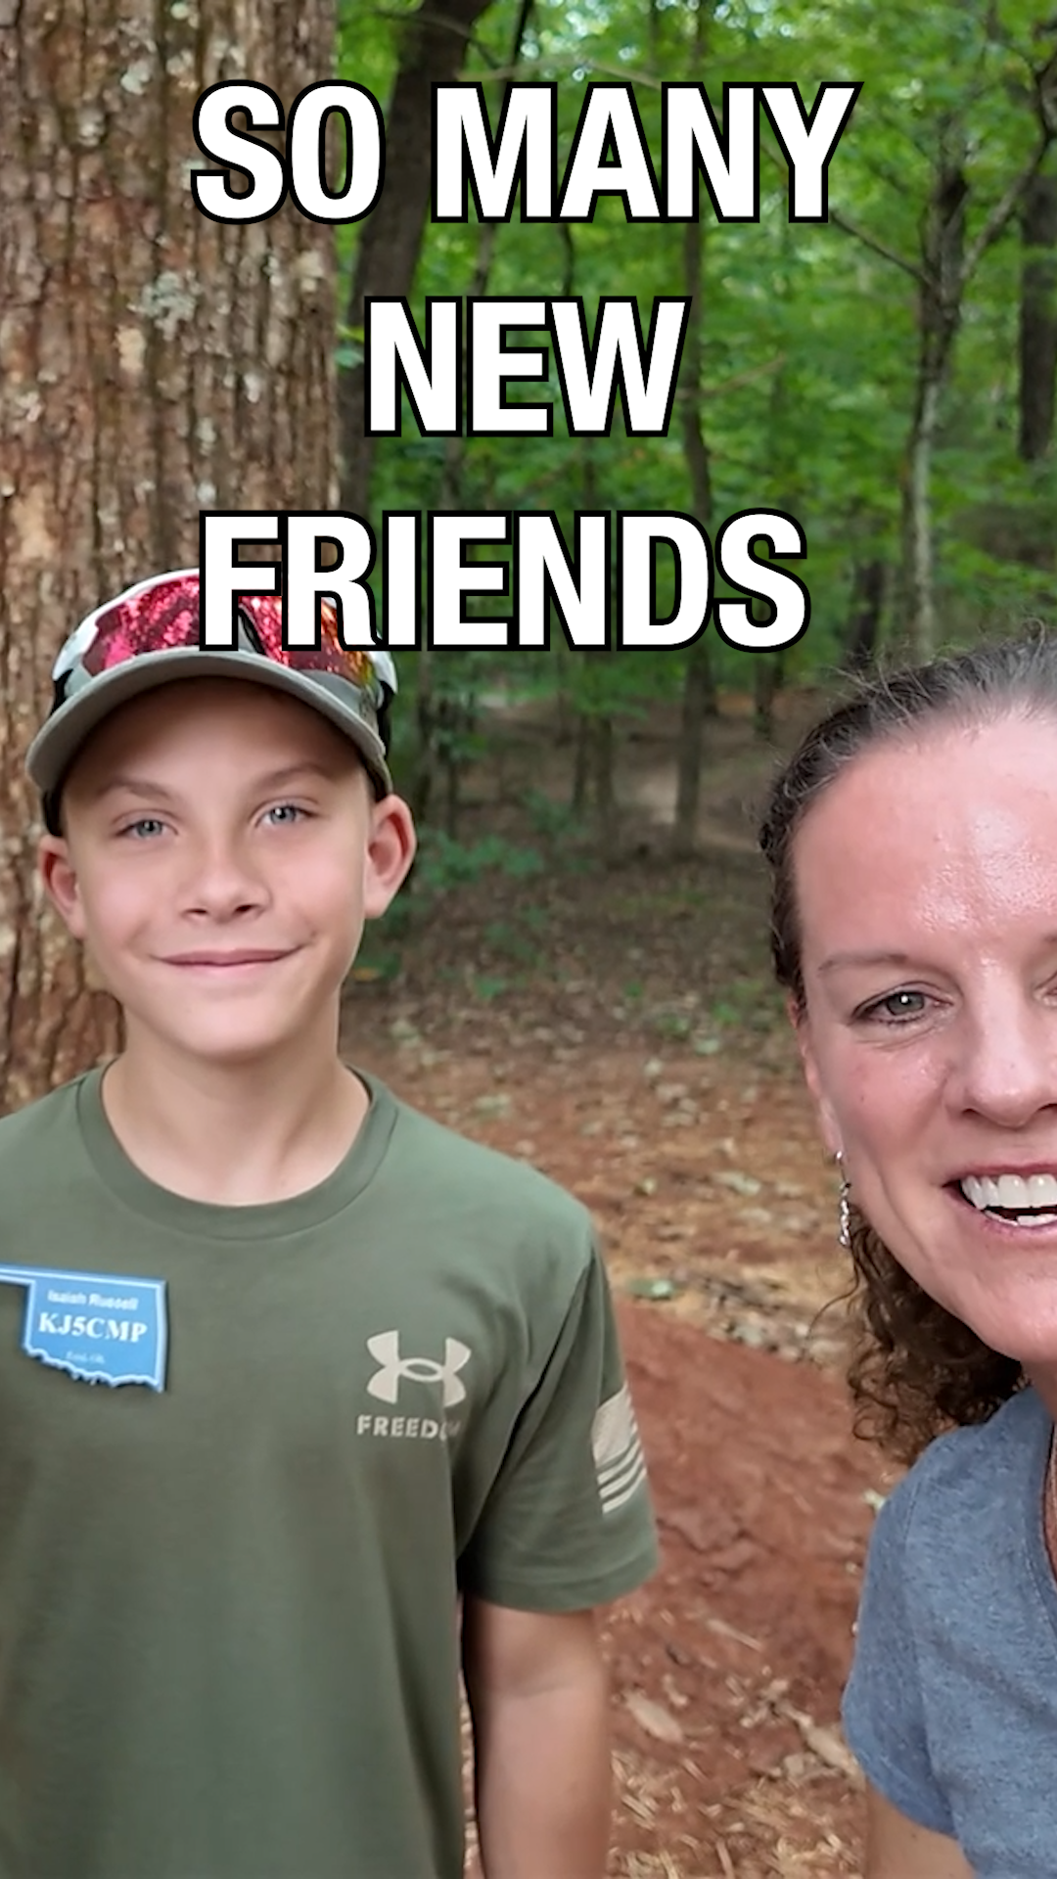
Fun (in case we can’t play the video)
Notes:
If the video on the previous slide doesn’t work, just talk to the slides.

Slide 31
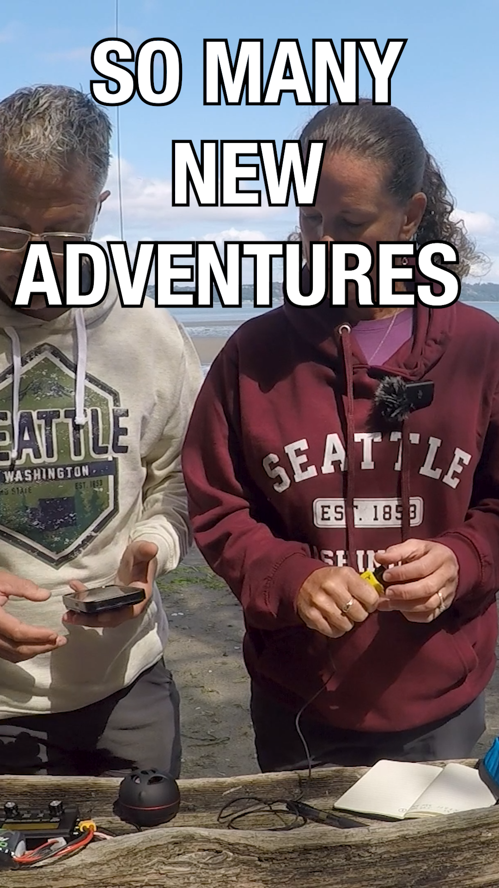
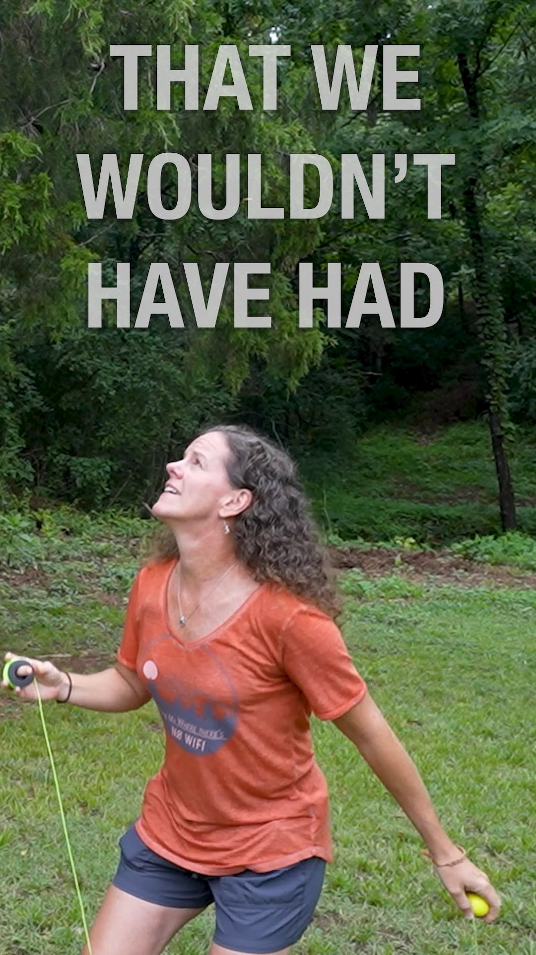

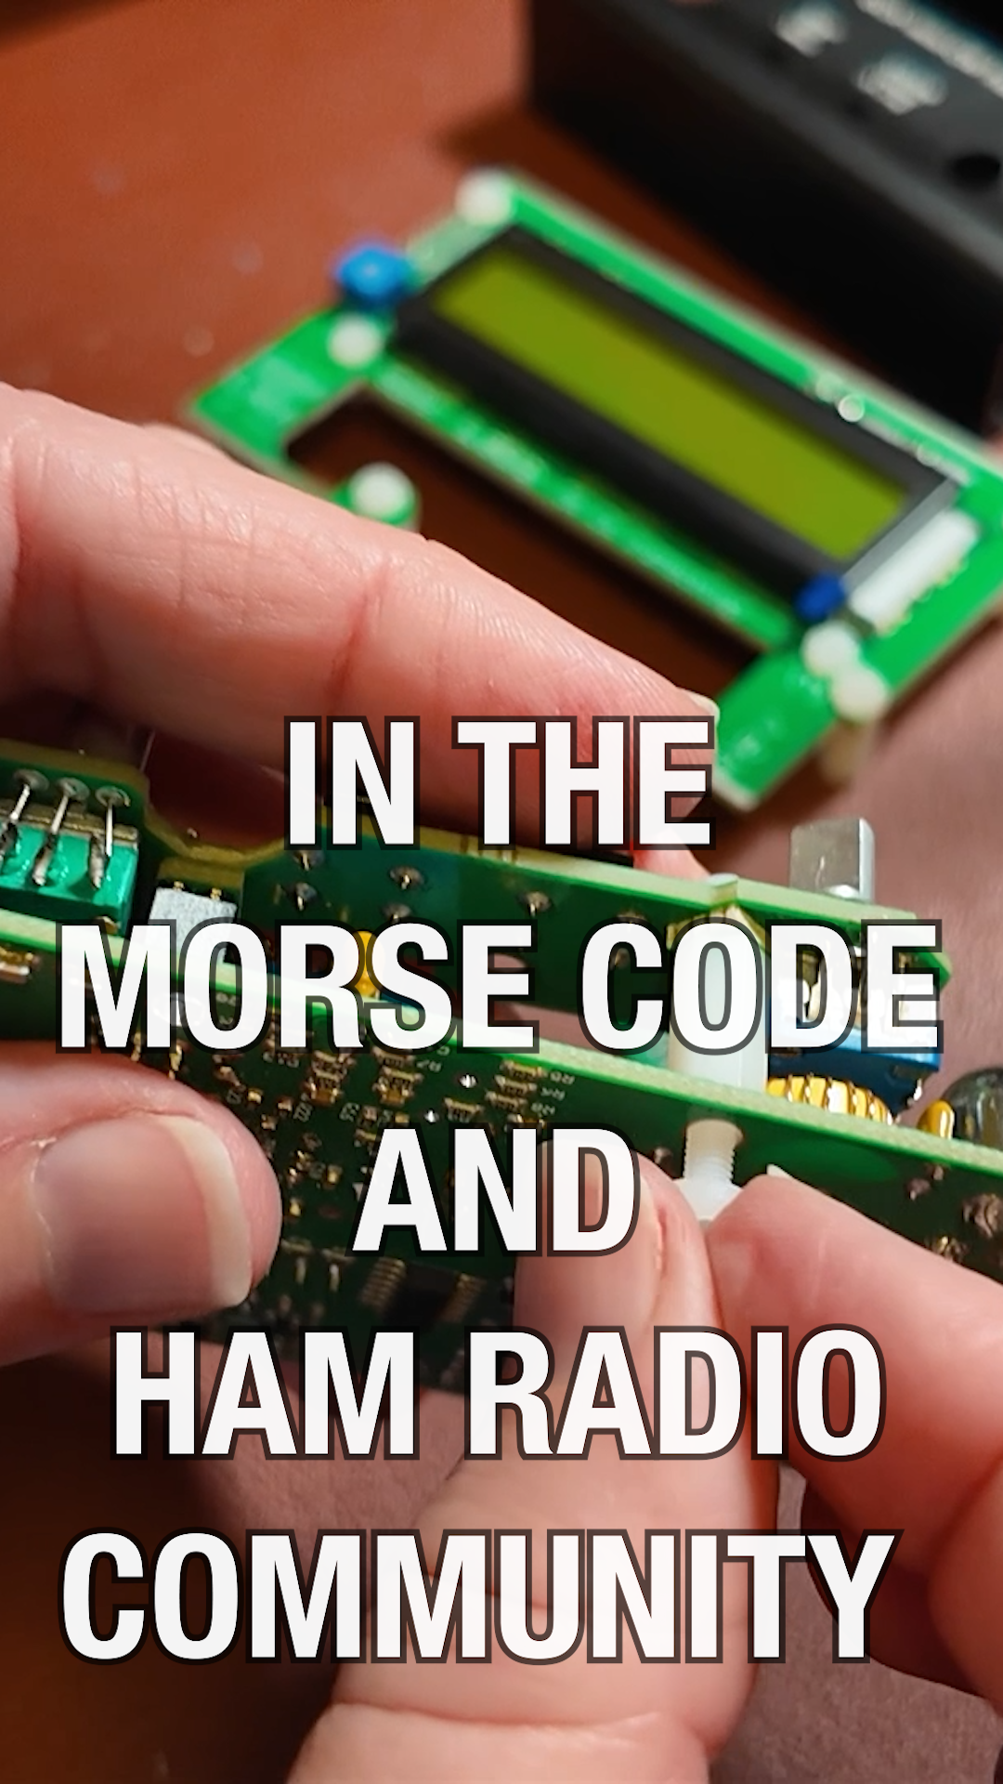
Fun (in case we can’t play the video)
Notes:
If the video on the previous slide doesn’t work, just talk to the slides.

Slide 32
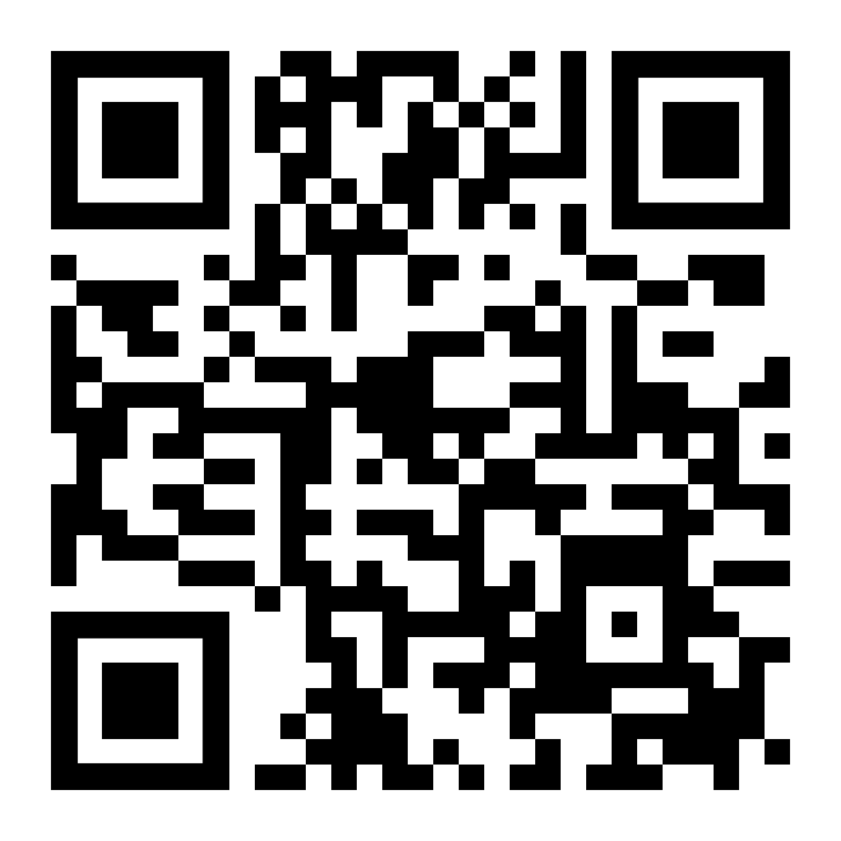
Getting Started
learnmorsecode.org
for anyone wanting to learn
why
learning
getting licensed
tools and games
classes and clubs
Notes:
We’ll wrap up with this. We created a website, learnmorsecode.org, to have everything we would have wanted to know. We made it so that anyone who loves morse code could share it with anyone who expresses interest. It starts with the why, outlines how to learn, getting licensed, links to tools and games, and lists the many fantastic classes and clubs.

Slide 33
First step to learn morse code
Our recommendation: Morse Mania
Makes learning a game
Learn by sound (set character speed to 30wpm+)
Don’t aim to get 100% right – just get 50-70% right
Have fun!
Notes:
If you want to learn morse code and walk away remembering just ONE THING, this would be it (from us). Just get started. Grab Morse Mania, set it to 30wpm, and learn.

Slide 34
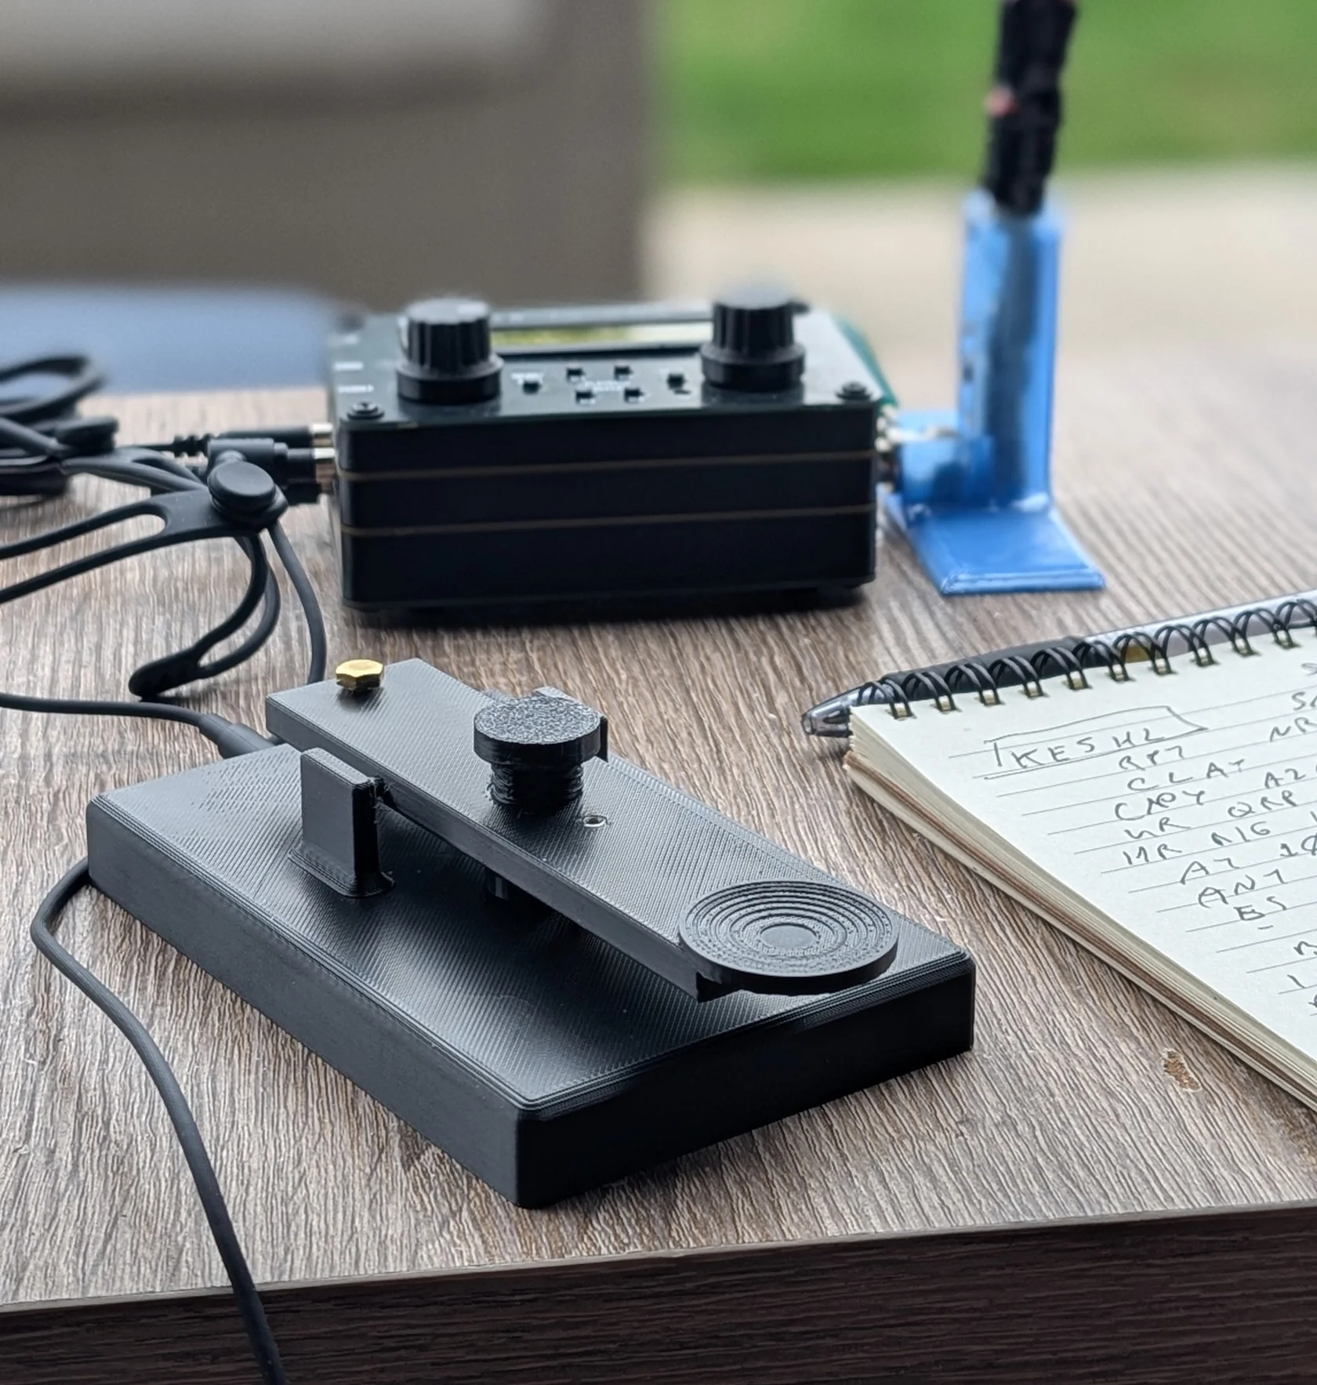
One more thing: Our Key
We made a key, the Duo Straight Key One.
shop.hamradioduo.com
Notes:
Oh yay, and if you haven’t seen it. We made a key.
Thank you everyone.

Slide 35
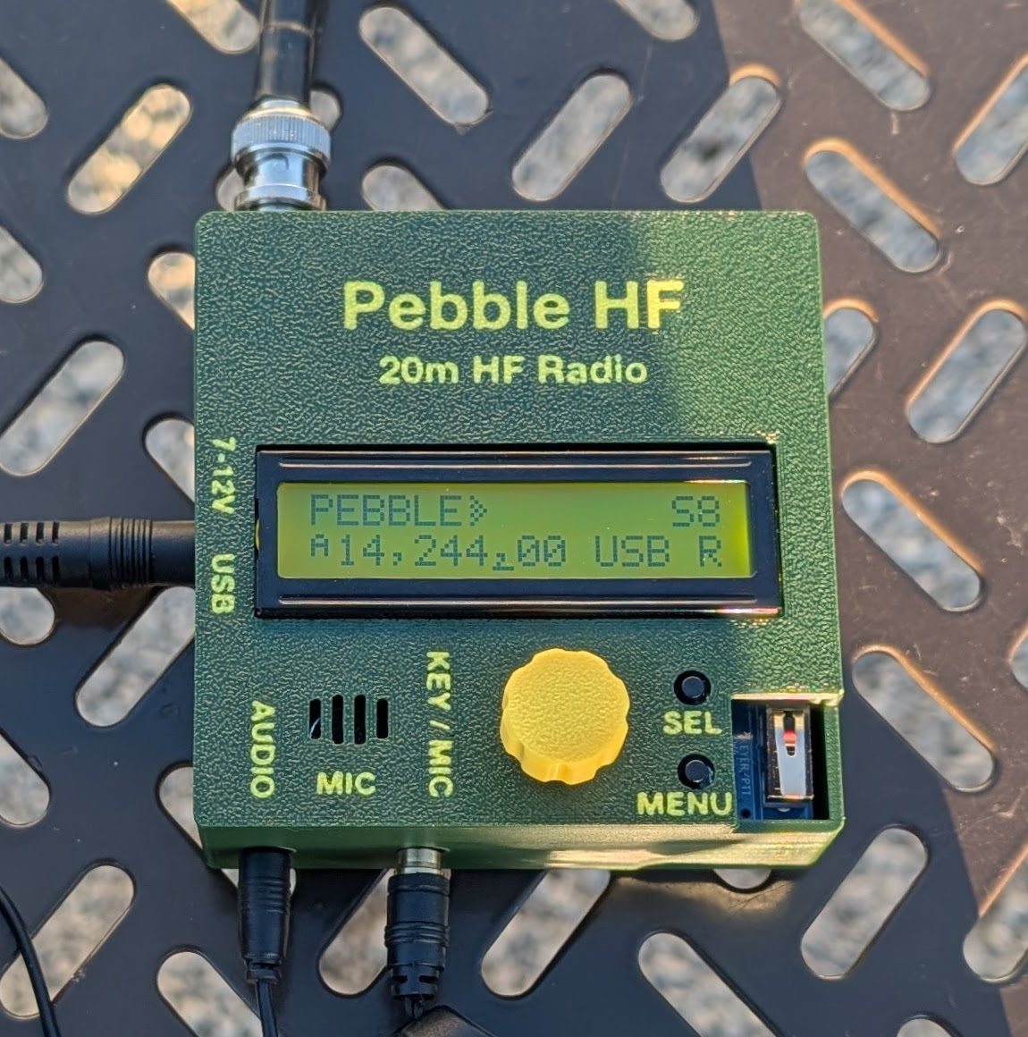
pebblehf.com

Slide 36
Questions?
Practice, patience, and persistence are the keys to mastering any language.
— Sandrine Elliot

